Slide 1
From the Family Farm to the Great Smoky Mountain National Park
Telling the story

Slide 2
What is the Question?
Question: How did the land my great-great-great grandparents Hughes settled in the early 1800s become part of the Great Smoky Mountain National Park?
… what is the story behind the loss of the land?

Slide 3
What do we know to start with?
History/genealogy of the families
Have the census records – and have analyzed them for clues
Research plan: Obtain and work with the land records. (What can we learn from the land records? )

Slide 4
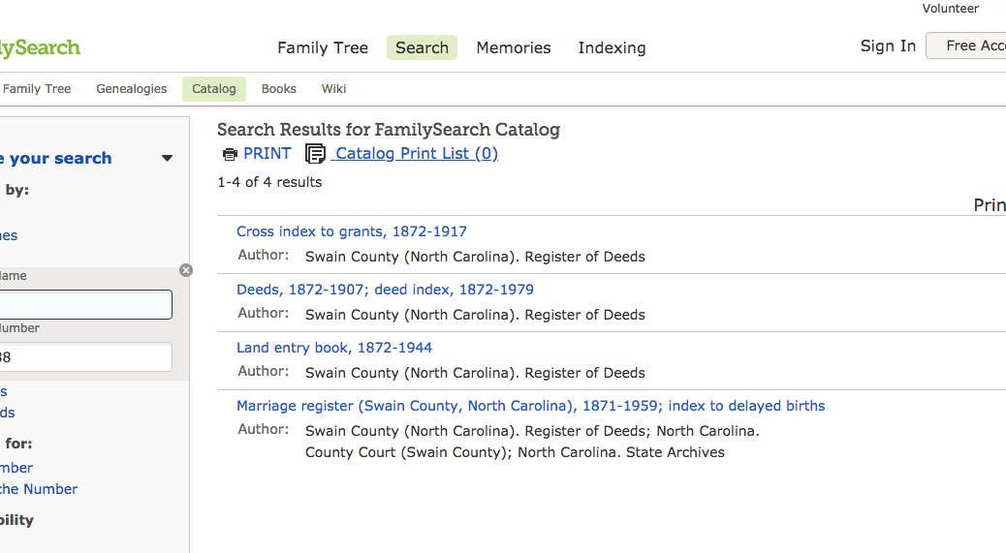
Are Swain Co. deed records available from FamilySearch.org?

Slide 5
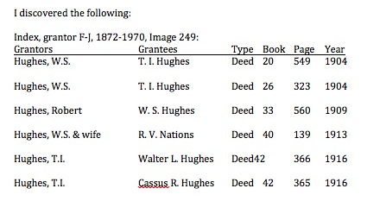
Nice chart of info found
Always note the image
number.

Slide 6
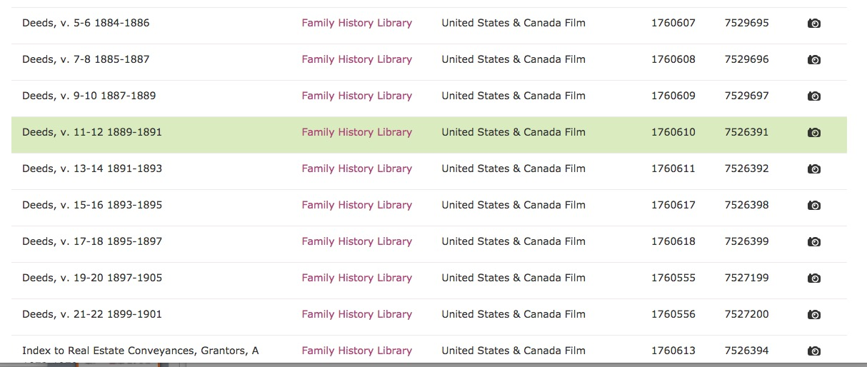
Read the deeds, not just the index
A lovely string of cameras

Slide 7
Write up your research!
Write as you go
  It helps you research
  It gives you a starting document
Make it interesting and understandable.
  Edit. Edit. Edit.
  Have others read it and heed suggestions.
Distribute it
  Family and friends
  Libraries and archives
  Publish it in a journal or newsletter about the area or family.

Slide 8
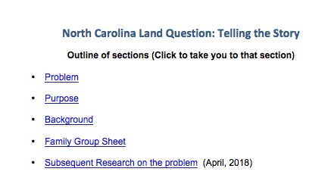
A Table of Contents helps you achieve a reader friendly organization

Slide 9
Some elements that help a reader enjoy what you wrote
A table of contents
Page numbers
Headers that mark sections
Careful, concise writing.
Maps
Pictures of people and places
Charts
Other?

Slide 10
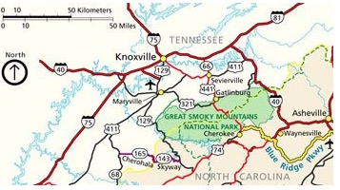
A map helps orient your reader.

Slide 11
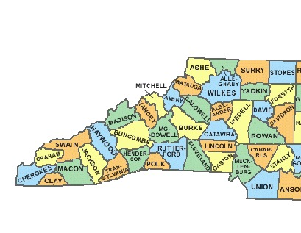
Map from FamilySearch
Research Wiki: North Carolina
Swain Co. is in Western NC

Slide 12
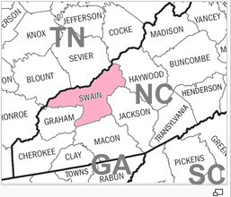
Map from FamilySearch Research Wiki
North Carolina > Swain County
Shows Swain Co. in relation to other states and counties.

Slide 13
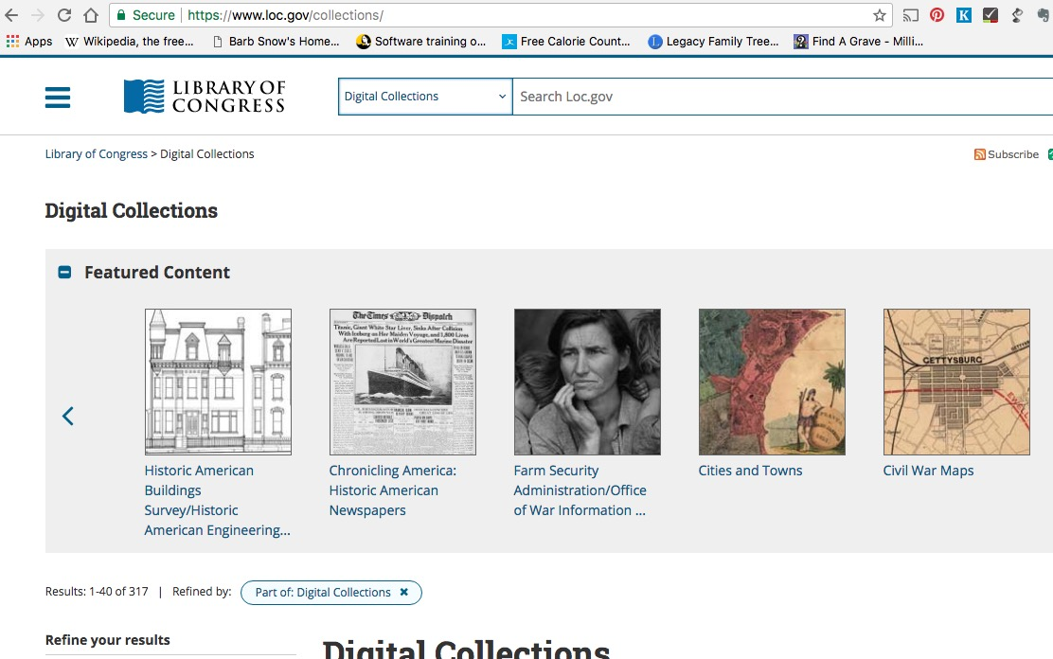
Library of Congress: Digital Collections https://www.loc.gov/collections/
SEARCH BOX
Choose to search Maps here

Slide 14
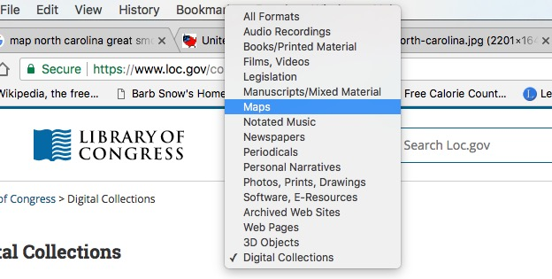
LOC Digital Coll > Maps
Select Maps from the pop up box of options.

Slide 15
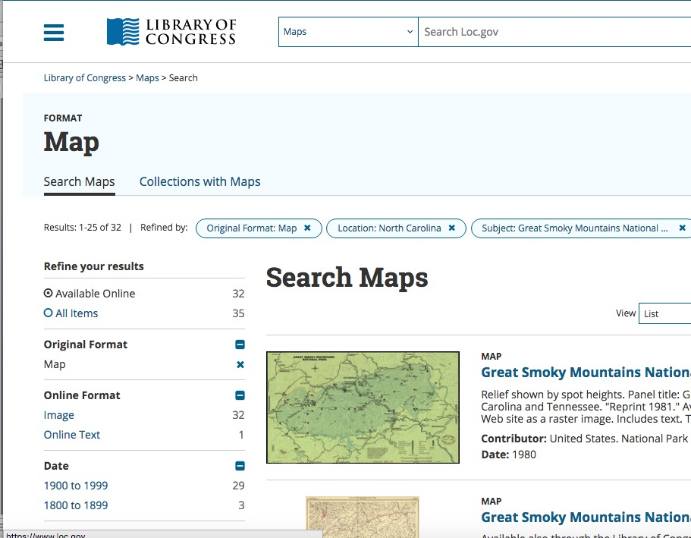
LOC Digital Library
I searched North Carolina Great Smoky…

Slide 16
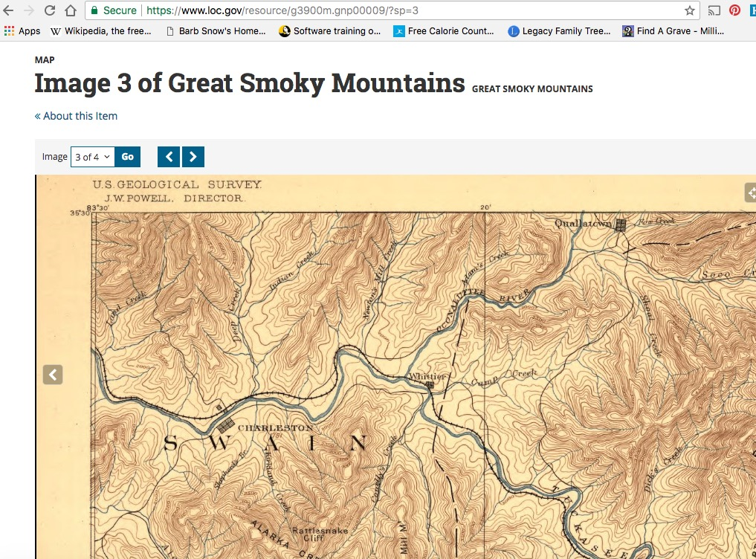
Topographical map showing Oconaluftee river in Swain Co.

Slide 17
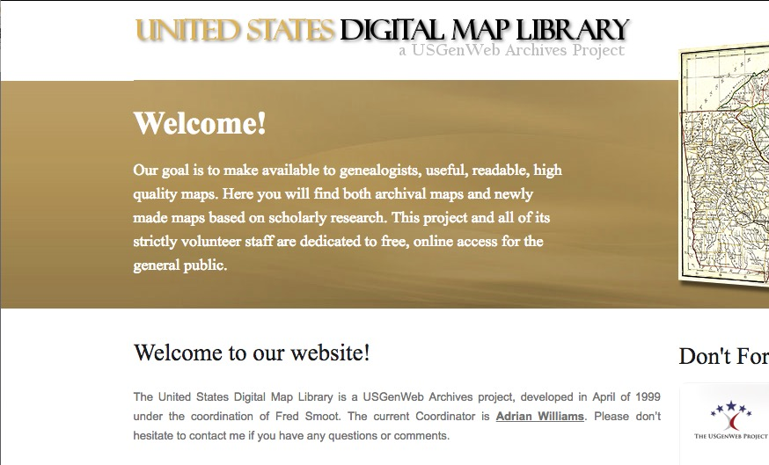
U.S. GenWeb Digital Map Library

Slide 18
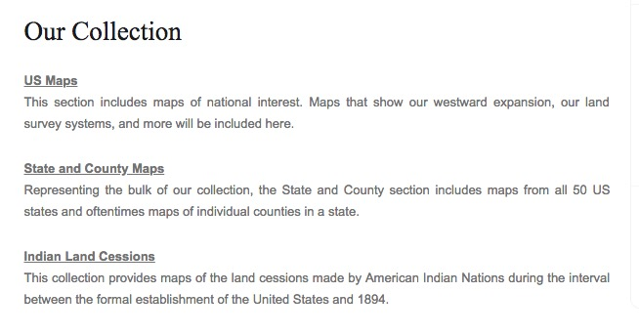
U.S. GenWeb DML Collections
This site has more ambition than
content, but is still worth a check

Slide 19
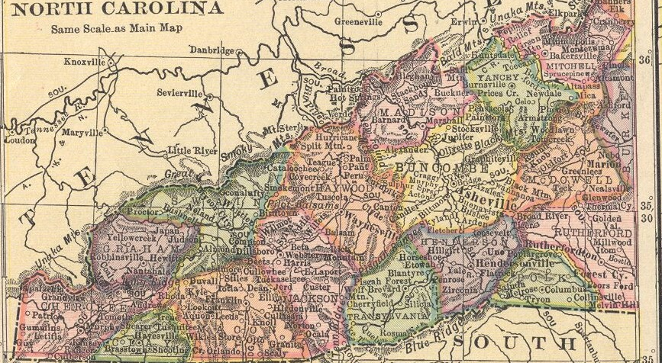
1910 Map

Slide 20
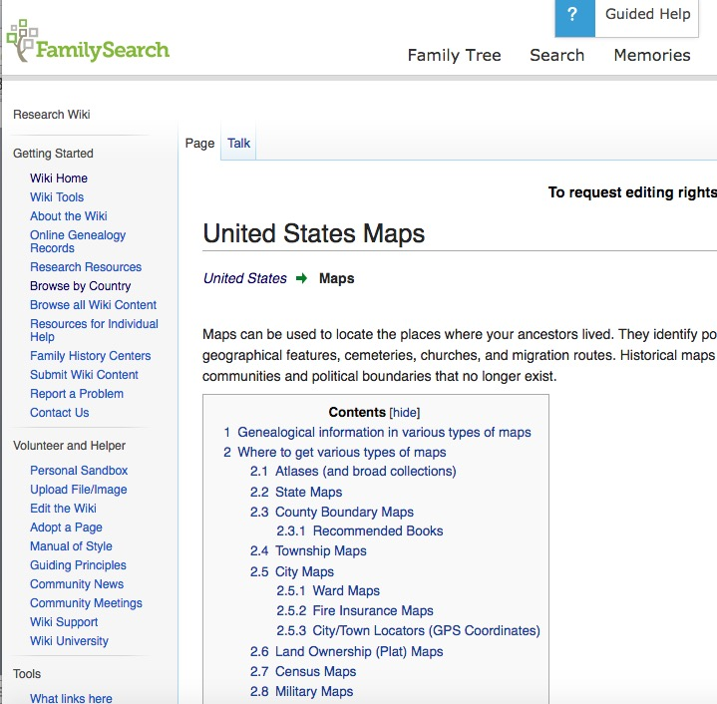
FamilySearch Research Wiki
U.S. Maps

Slide 21
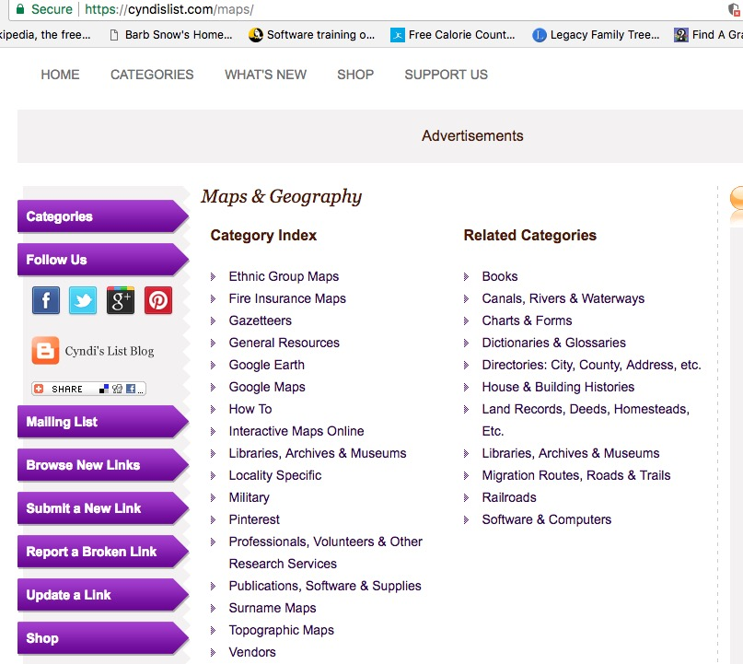
Find more maps online through Cyndi’s list

Slide 22
Was there a court battle?
In NC courts? Which court?
Federal records?
Newspaper accounts?
One question at a time…
Let’s start by looking at NC courts

Slide 23
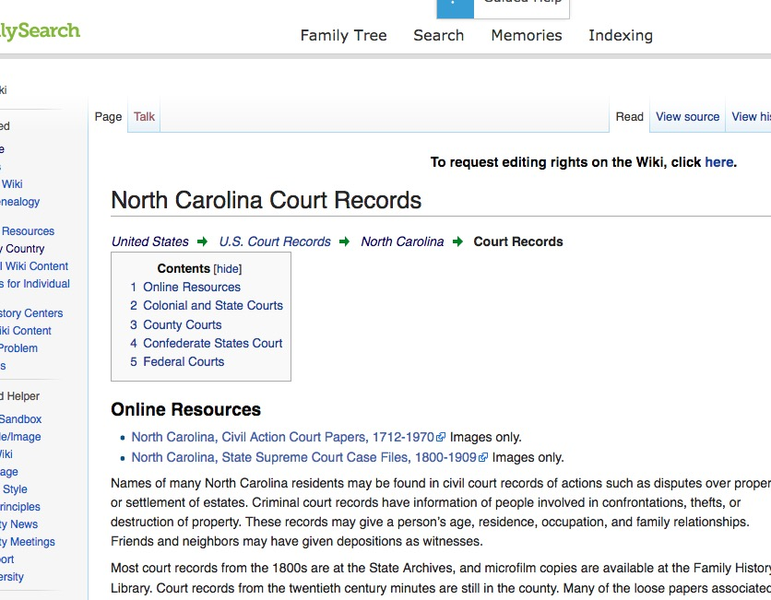
FamilySearch.org Research Wiki
North Carolina > Courts

Slide 24
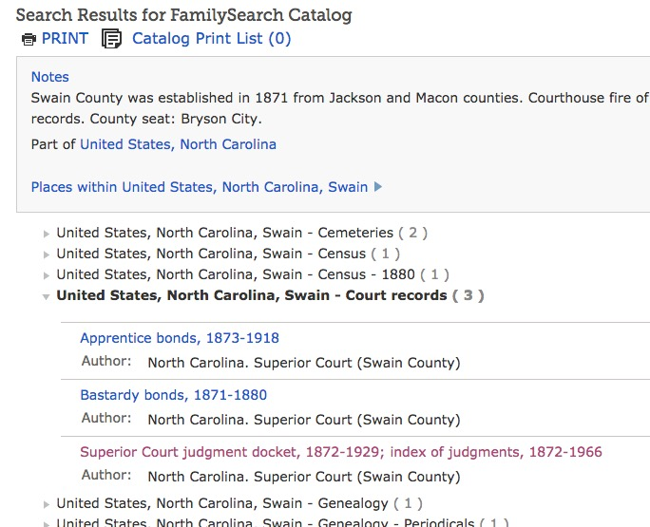
I’m going to start locally…Swain Co. Court records filmed by FHL

Slide 25
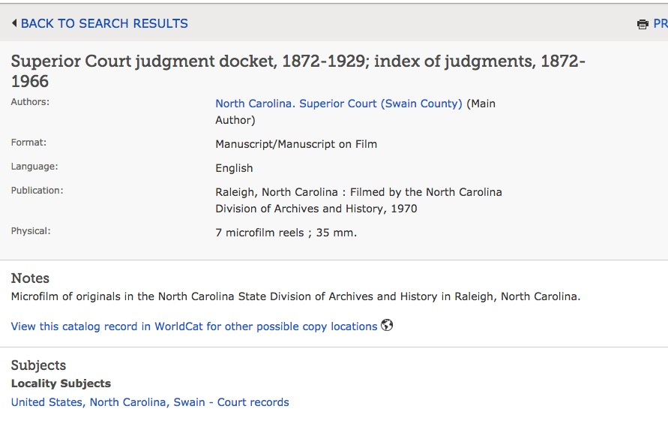
Swain Co. Superior Ct. records filmed by FHL

Slide 26
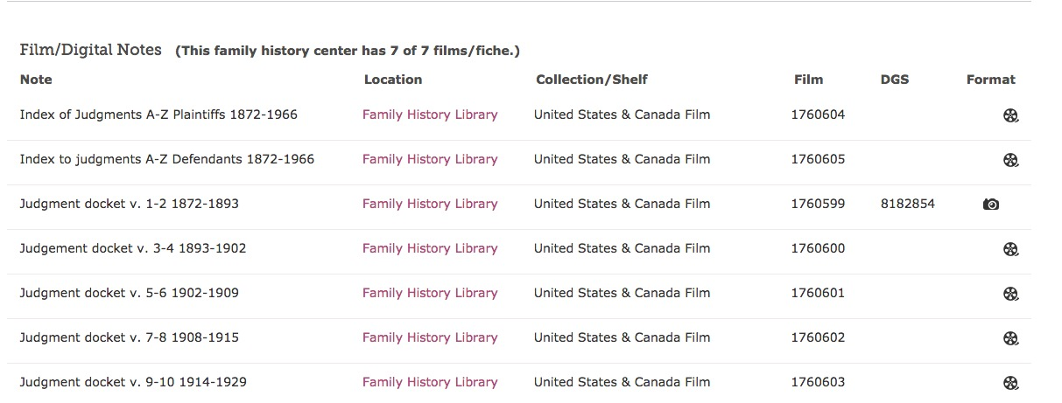
The index not yet digitized

Slide 27
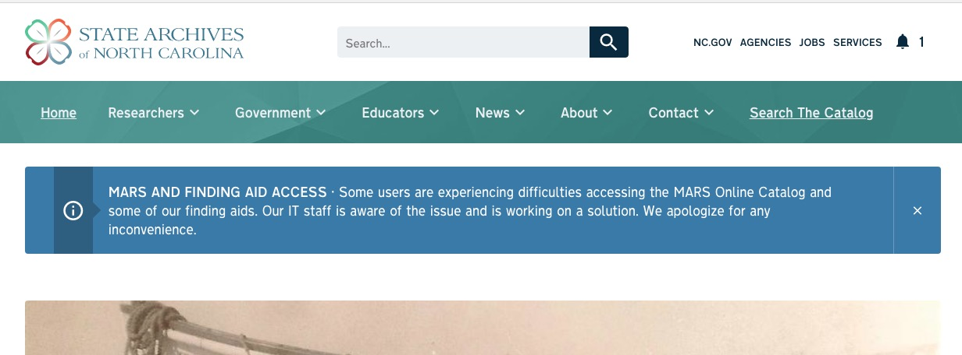
But! original was at the
North Carolina Archives
It was the case that I could not search the catalog. However even if the search
function is there, it can be difficult to find what you need.

Slide 28
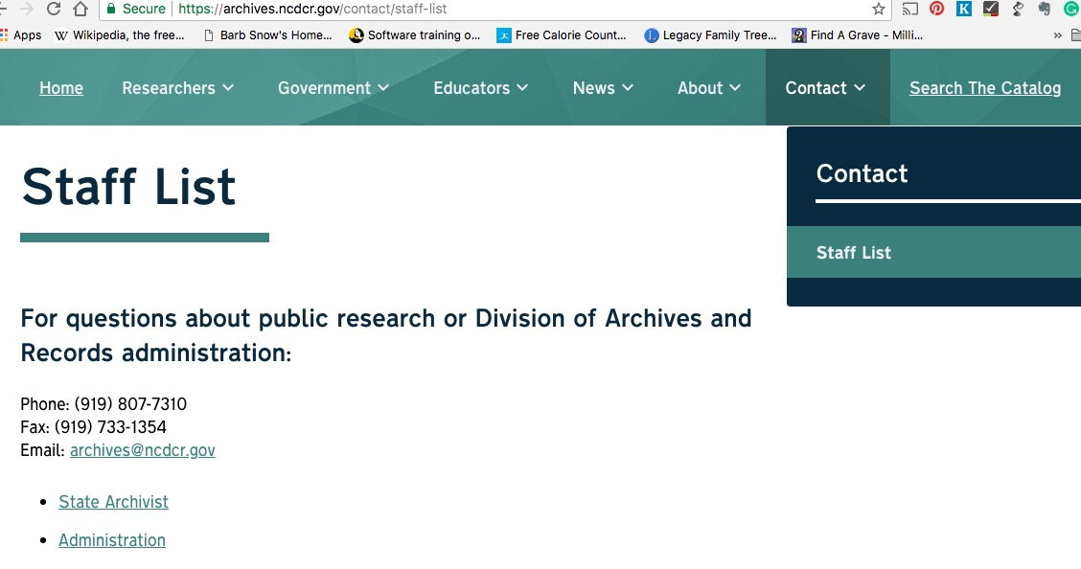
Ask A Librarian
Your new best friend.

